Slide 1


DOM
Dissolved Organic Matter (2022FA)
Investigating the optimal conditions to remove humic acid in water
More at https://github.com/AguaClara/Dissolved-Organic-Matter
Rachel Lai | rml267@cornell.edu Nhi Nguyen | npn25@cornell.edu
Zachary Kwon | zk49@cornell.edu Brooke Paykin | bsp67@cornell.edu
Mateo Aranzazu | ma956@cornell.edu
Dissolved Organic Matter | Research | Final Presentation Fall 2022 | Page 1
Notes:
Mateo
Hi we are DOM (dissolved organic matter). We were previously the subteams Humic Acid Removal and Activated Carbon. We are investigating the optimal conditions to remove dissolved organic matter in water. In the lab, we model dissolved organic matter with humic acid which we pump into our water. You can find more about our work on this github link. My name is Mateo… [Let everyone quickly introduce themselves]

Slide 2
Table of Contents
Background/Introduction
Schematic Drawing
Experimental Setup
Current Work
Results and Analysis
Conclusions and Future Directions
Dissolved Organic Matter | Research | Final Presentation Fall 2022 | Page 2
Notes:
Mateo
Read off the different components of this presentation

Slide 3
Goal
To determine the effectiveness of implementing coagulant with powdered activated carbon and/or clay to remove humic acid from drinking water to improve the capability of AguaClara water treatment plants.
Dissolved Organic Matter | Research | Final Presentation Fall 2022 | Page 3
Notes:
Mateo
This year we will focus on determining the effectiveness of implementing coagulant with powdered activated carbon and/or clay to remove humic acid from drinking water to improve the capability of AguaClara water treatment plants.
Based on feedbacks from the plant operators from Gracias Honduras water treatment plant, there is a problem with flocs formed not being dense enough to be filtered out. That is why we are looking into whether or not clay and activated carbon can help form heavier, denser flocs that will settle better.

Slide 4
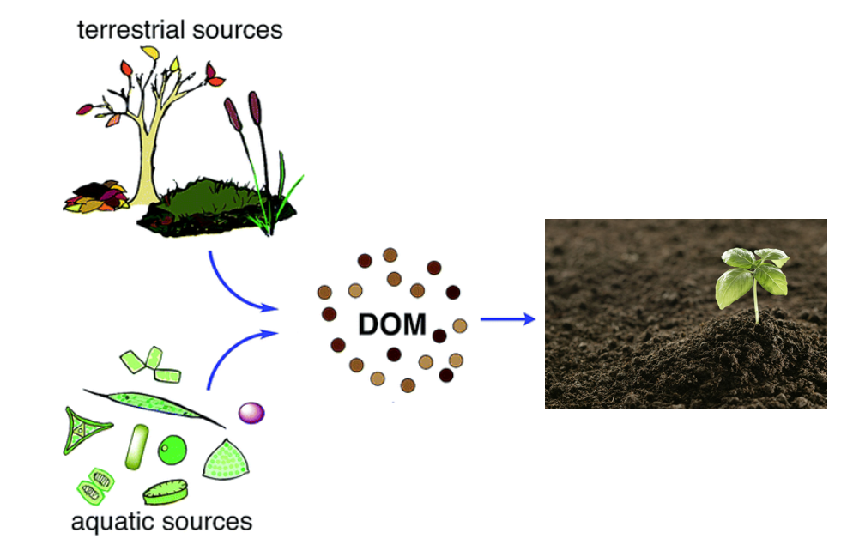
Background
What is humic acid (HA)?
Color, taste and odor problems
Increased heavy metals and organic pollutants
Reacts with chlorine to make chloroform
How can we deal with humic acid?
Flocculation
Coagulant (PACl)
w/ Clay
w/ Powdered Activated Carbon (PAC)
Figure 1: Formation of dissolved organic material from terrestrial and aquatic sources
Dissolved Organic Matter | Research | Final Presentation Fall 2022 | Page 4
Notes:
Zach
What is humic acid?
Humic acid is a type of Dissolved Organic Matter (DOM), which consists of particles present in surface and groundwater and mainly results from plant and animal decay. Although humic acid is beneficial to plants because of their stimulation for plant growth and increase of plant disease resistance, it is viewed as a problem for the drinking water treatment process.
Humic acid has a negative effect on water quality because it causes problems with the color, taste, and odor of drinking water and is associated with increased levels of complex heavy metals and adsorbed organic pollutants. In addition, humic acid has the ability to react with chlorine, which creates a harmful byproduct known as chloroform.
How can we deal with humic acid in drinking water?
Our subteam’s method for removing humic acid from drinking water is through a process known as flocculation. Flocculation is driven by coagulant, which is a substance that clumps the impurities in water together in bunches -called flocs- that can be easily removed in the sedimentation tank. Thus, we need to determine a dosage of coagulant that is high enough to remove humic acid, but not enough to prevent flocculation.
After finding this optimal coagulant dosage, we will use coagulant with clay and/or activated carbon and optimize the resulting system to remove the most humic acid with the least amount of our solutions.
Information Citation:
Radian, A., &amp; Mishael, Y. (2012). Effect of humic acid on pyrene removal from water by polycation-clay mineral composites and activated carbon. Environmental Science &amp; Technology, 46(11), 6228–6235. https://doi.org/10.1021/es300964d
Image citation:
Lin, V. S. (2015). Research highlights: Challenges in the characterization, storage, and isolation of natural organic matter. Environmental Science: Processes & Impacts, 17(12), 2002–2005. https://doi.org/10.1039/c5em90046h

Slide 5
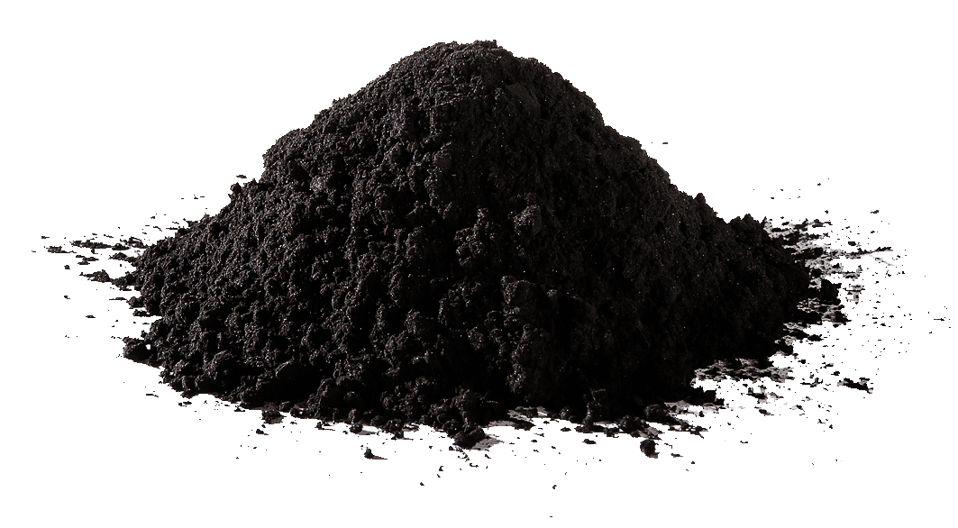
Background
How can clay and powdered activated carbon improve the flocculation process?
Create denser flocs
Porous and hydrophobic particles
Higher molar masses
Clay vs. Powdered Activated Carbon
Clay is less expensive
PAC is better at absorbing DOM
Figure 2: Powdered Activated Carbon (PAC) from Eleven Carbon Company
Dissolved Organic Matter | Research | Final Presentation Fall 2022 | Page 5
Notes:
Zach
How can clay and activated carbon improve flocculation?
Normally, according to Dr. Monroe Weber-Shirk, the flocs of humic acid and coagulant are not denser than water, which prevents the removal of such flocs in the sedimentation tank. Through the addition of clay and/or powdered activated carbon, denser flocs are able to be formed since these materials are porous, hydrophobic, and have higher molar masses. Take note: the clay and PAC are said to create denser flocs, not more flocs!
Clay vs. Powdered Activated Carbon
In a meeting with Dr. Weber-Shirk, we spoke about the difference between clay and powdered activated carbon. According to Dr. Weber-Shirk, clay is less expensive than PAC, but PAC is better at adsorbing DOM. This statement was corroborated by a paper from Biswas et al. We plan to retrieve data justifying these statements and find optimal coagulant, clay, and PAC dosages to remove humic acid from drinking water.
Information Citation:
Biswas, S., Fatema, J., Debnath, T., &amp; Rashid, T. U. (2021). Chitosan–Clay Composites for wastewater treatment: A state-of-the-art review. ACS ES&amp;T Water, 1(5), 1055–1085. https://doi.org/10.1021/acsestwater.0c00207
Image Citation:
Powdered activated carbon. Eleven Carbon™. (2022, April 3). Retrieved October 17, 2022, from https://elevencarbon.com/powdered-activated-carbon/

Slide 6
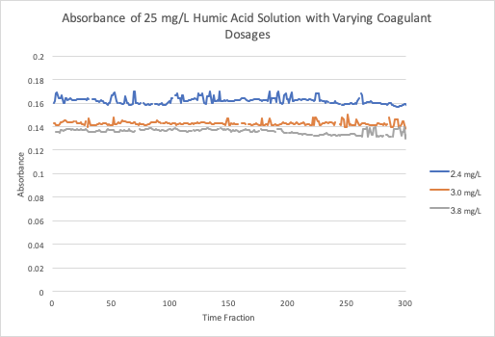
Work from Prior Semesters
From Fall ‘19 &
Spring ‘20 team
Figure 3: Graph of the absorbances of the clean water with varying concentrations of coagulant in a solution with 25 mg/L of humic acid
There is a limit to the concentration of coagulant for minimizing the amount of humic acid in water.
Dissolved Organic Matter | Research | Final Presentation Fall 2022 | Page 6
Notes:
Nhi
Here we move on to discuss about what the previous semester subteams has found. Looking at the first two rows of this table, where the humic acid concentrations are at 5 and 10 mg/L, we can see a negative relationship between humic acid and the optimal coagulant dosage needed to remove them. However, literature has suggested that there should be a positive correlation between these two so we suspected that the optimal coagulant dosage at 10 mg/L humic acid could be an anomaly. The other data points show a positive correlation: the greater the amount of humic acid in water, the greater the amount of coagulant is needed to remove them.
Moving on to this graph over here, the 2019 and 2020 subteams had found that there is a upper limit as to how much you could increase coagulant dosage to effectively remove humic acid.
Therefore, we have speculated that the slope of the decrease in humic acid levels off after we have reached a certain amount of coagulant.
Citations:
Li, L., Shanti, M., & Wang, C. Humic Acid, Floc/Sed Model, Fall 2019. Retrieved from https://github.com/AguaClara/humic_acid/blob/master/Fall%202019/Humic_Acid_Fall_2019_Report.ipynb
Bradford, T., et al. Humic Acid Removal, Spring 2020. Retrieved from https://github.com/AguaClara/humic_acid/blob/master/Spring%202020/HA_Report1_Spring2020.ipynb

Slide 7
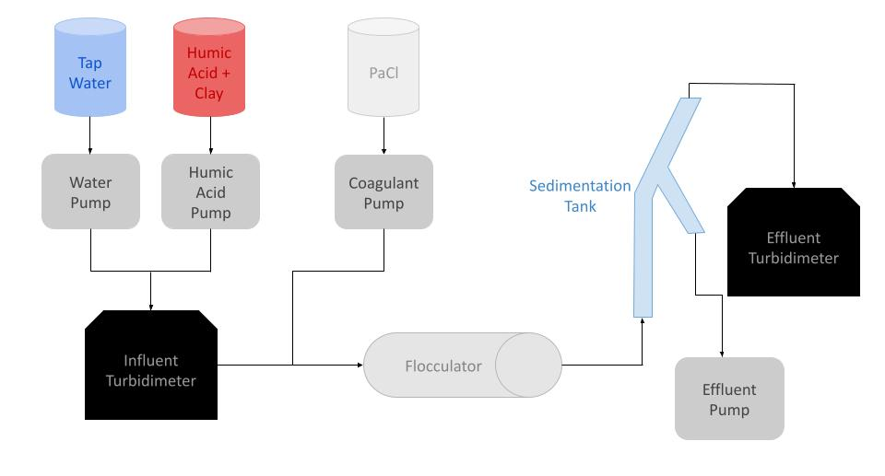
Schematic Drawing
Figure 4: Schematic drawing of the experimental set up for testing varying humic acid, coagulant, and clay concentrations
Dissolved Organic Matter | Research | Final Presentation Fall 2022 | Page 7
Notes:
Nhi
Brief schematic drawing of process/show general flow of solutions:
Clay is added to our humic acid solution which is then pumped in with water and combined before entering the influent turbidimeter. We use PaCl, (also known as polyaluminum chloride) as our coagulant, which is added to the humic acid - water solution and enters the flocculator where flocs form. It then moves into the sedimentation tank where the wastewater with floccs travels down the sloping branch due to gravity, and the clear water rises to the top. The clean water will then enter the effluent turbidimeter to measure the absorbance and turbidity of the water. There should be a smaller turbidity with the effluent stream compared to the influent stream as the turbidimeter measures the clarity of the fluid.

Slide 8
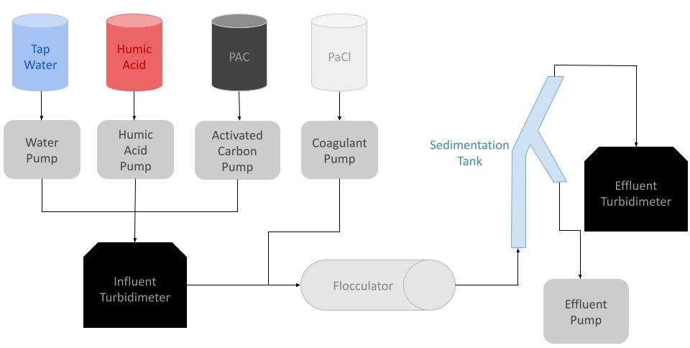
Schematic Drawing
Figure 5: Schematic drawing of the experimental set up for testing varying humic acid, coagulant, and PAC concentrations
Dissolved Organic Matter | Research | Final Presentation Fall 2022 | Page 8
Notes:
Nhi
We have a similar schematic for the other experiments we will like to run. The main differences is that there will not be clay added to the humic acid solution and that we will have another pump with activated carbon which will combine with humic acid and water before entering the influent turbidimeter.

Slide 9
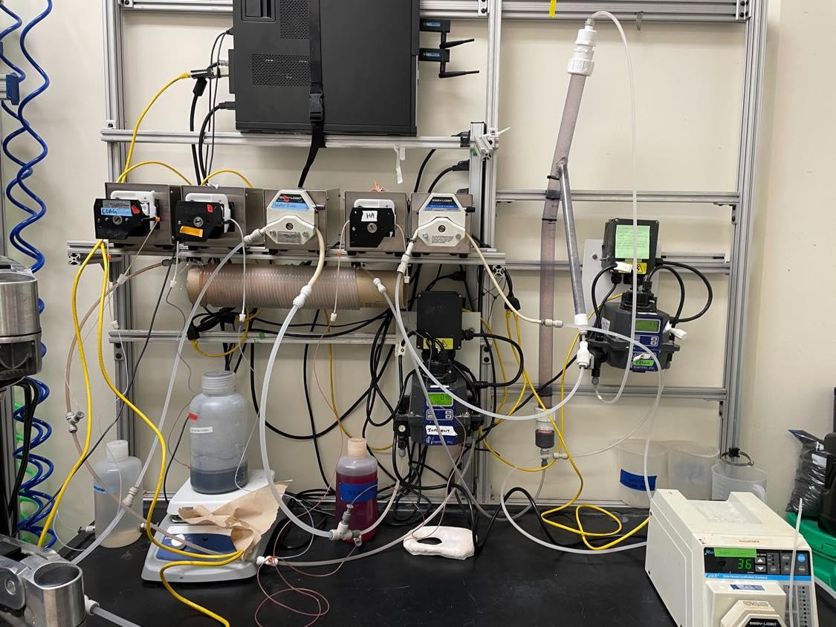
Experimental Setup
Water pump
Sedimentation Tank
Coagulant pump
Wastewater pump
Activated carbon pump
Humic acid pump
Effluent Turbidimeter
Influent Turbidimeter
Flocculator
Figure 6: Image of lab set-up and experimental design
Dissolved Organic Matter | Research | Final Presentation Fall 2022 | Page 9
Notes:
Nhi
We have five pumps: one for coagulant, activated carbon, humic acid, and water. A wastewater pump is used to ensure that the wastewater leaves the system.
Water is pumped from the inlet and combined with the humic acid and activated carbon which then then goes into the influent turbidimeter. They combine with coagulant and goes into the flocculator. Afterwards, it goes into the sedimentation tank and then the effluent turbidimeter.

Slide 10
Methods
Find optimal coagulant dosage by
Varying coagulant dosage for 5 mg/L of humic acid concentration with
Clay
Activated carbon
Increase concentration of humic acid and repeat
Dissolved Organic Matter | Research | Final Presentation Fall 2022 | Page 10
Notes:
Rachel`
In our ProCoDA method file, we are using the same setpoints as the ones used last year which you can see in our appendix slides (page 19). To find the optimal coagulant dosage, we will make solutions of various concentrations of coagulant for 5 mg/L of humic acid solution. The humic acid solution will also have clay which helps provide turbidity readings since the density of humic acid and water are similar. Afterwards, we will run same concentration of humic acid with the optimal coagulant dosage found in the previous experiment with activated carbon and varying amounts of clay, to see if activated carbon can also create turbidity with greater ability for floc formation. We will repeat these trials for increasing concentrations of humic acid.
Materials: Clay helps provide turbidity readings due its larger particle size. Humic acid is used as a model of dissolved organic matter. Activated carbon is used as substitute for clay and for other filtering effects. The pumps pump fluid into and out of the system. The turbidimeter measures how clear the sample is. The sedimentation tank separates floccs from clean water. The flocculator is where flocs form.

Slide 11
​​
Coagulant Concentrations
5 mg/L Humic Acid | 10 mg/L Humic Acid | 15 mg/L Humic Acid | 20 mg/L Humic Acid | 25 mg/L Humic Acid
Coagulant dosages: 0.8 mg/L 1.0 mg/L 1.2 mg/L 1.4 mg/L 1.6 mg/L 1.8 mg/L 2 mg/L | Coagulant dosages: 0.8 mg/L 1.0 mg/L 1.2 mg/L 1.4 mg/L 1.6 mg/L 1.8 mg/L 2 mg/L | Coagulant dosages: 1.6 mg/L 1.8 mg/L 2 mg/L 2.2 mg/L 2.4 mg/L 2.6 mg/L 2.8 mg/L | Coagulant dosages: 2 mg/L 2.2 mg/L 2.4 mg/L 2.6 mg/L 2.8 mg/L | Coagulant dosages: 2.4 mg/L 2.6 mg/L 2.8 mg/L 3.0 mg/L 3.4 mg/L 3.8 mg/L 4.0 mg/L
Table 1: Table of coagulant concentrations to use for different concentrations of humic acid.
Dissolved Organic Matter | Research | Final Presentation Fall 2022 | Page 11
Notes:
Rachel
For our experiments, we plan on making solutions of these coagulant concentrations for these dosages of humic acid based on experimental results from 2017-2020. We based these values from the table in Figure 3 where we are going to use values within 1 mg/L from the optimal coagulant dosage for those concentrations of humic acid. We have started running trials for 5 mg/L of humic acid.

Slide 12
​​
PAC Trials
For the PAC concentration, last year we used 5 g/L stock solution and then we varied the flow rate by adjusting the rate of the PAC on ProCoDA.
Kept HA and PaCl concentrations and flow rates constant
0.2 g/L HA at 0.2 mL/s
1 g/L PACl at 0.2 mL/s
Varied PAC (5 g/L) flow rates
Trial 1: 0.01 mL/s
Trial 2: 0.005 mL/s
Trial 3: 0.002 mL/s
Dissolved Organic Matter | Research | Final Presentation Fall 2022 | Page 12
Notes:
Rachel
Nhi:
for the PAC concentration, last year we used 5 g/L stock solution and then we varied the flow rate by adjusting the rate of the PAC on ProCoDA. Here’s what we used (extracted from Spring 2022 final presentation):
Kept HA and PACl concentrations and flow rates constant
0.2 g/L HA at 0.2 mL/s
1 g/L PACl at 0.2 mL/s
Varied PAC (5 g/L) flow rates
Trial 1: 0.01 mL/s
Trial 2: 0.005 mL/s
Trial 3: 0.002 mL/s
for the Spring 2020 Activated Carbon subteam, they used the values in this table:
https://raw.githubusercontent.com/brensolc/activated_carbon/master/Images/experiments.JPG
=> I think we should have higher concentrations of PAC because for 5 mg/L humic acid about 30 mg/L PAC is used.

Slide 13
Current Work
Finished turbidimeter calibration
Adjusted coagulant concentration to create flocs with 5 mg/L HA and 5 g/L kaolin clay
Dissolved Organic Matter | Research | Final Presentation Fall 2022 | Page 13
Notes:
Rachel
Since the symposium, we have recalibrated the turbidimeters after discovering we were using tubes that were too small for calibration. We then started our experiments. We made coagulant solutions ranging from 0.8-2.5 mg/L of coagulant for 5 mg/L of humic acid with 5 g of clay. This was strange because flocs were not forming despite the optimal coagulant dosage was found to be 1.6-1.8 in previous semesters. More about this in the next slide.

Slide 14
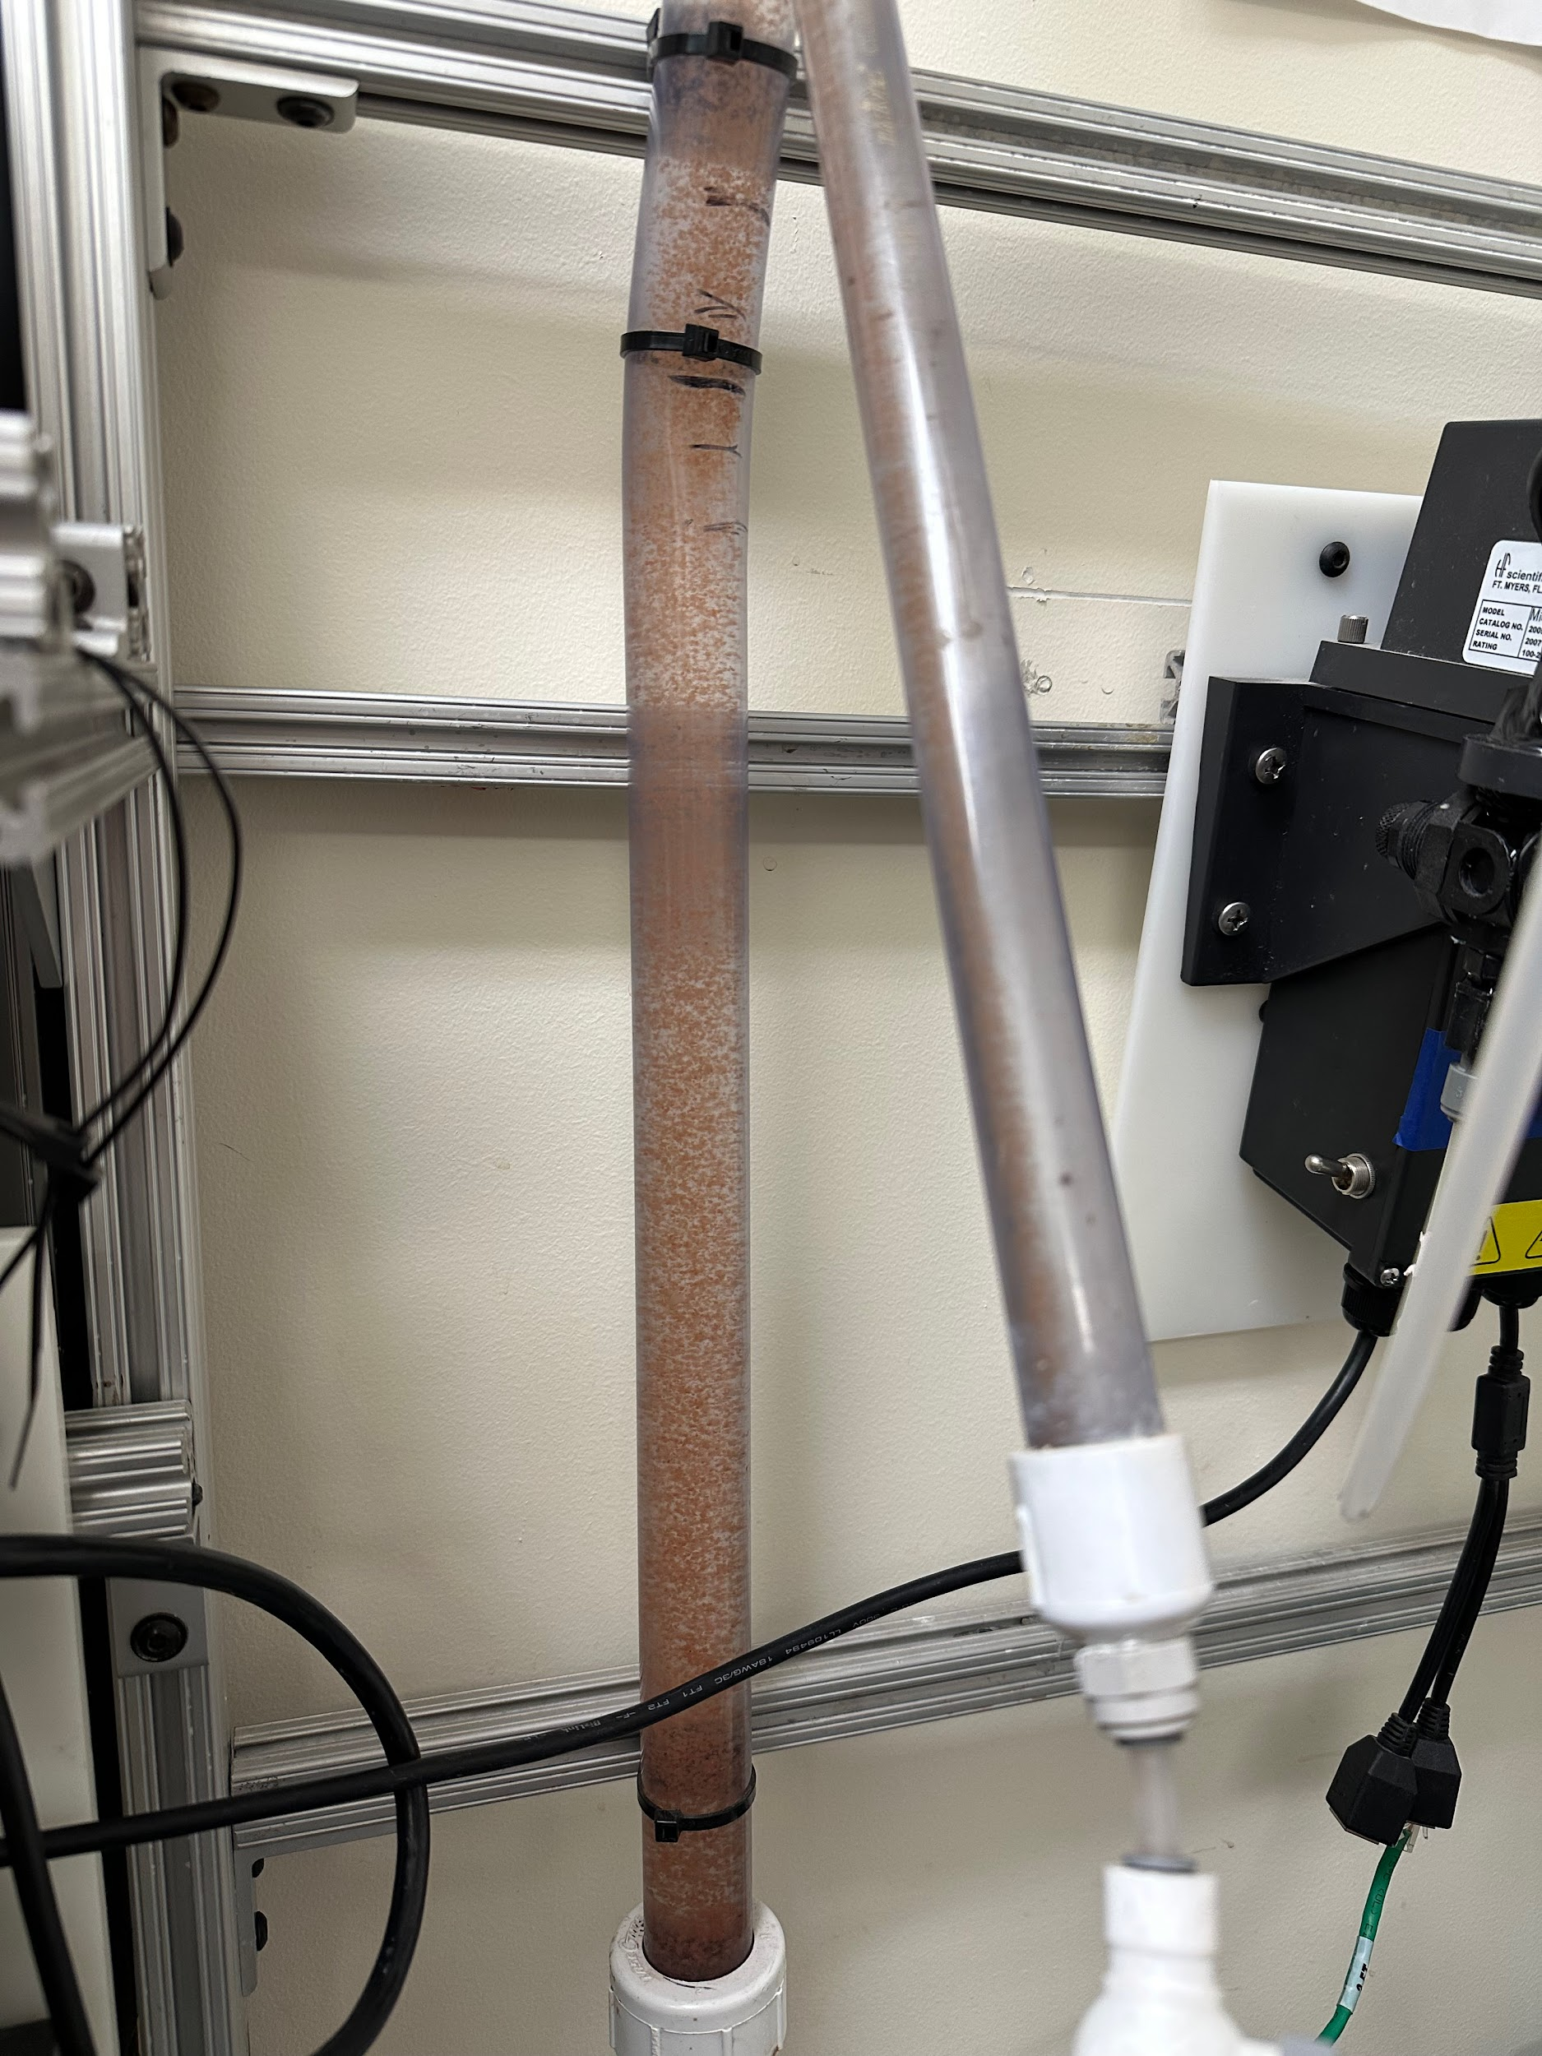
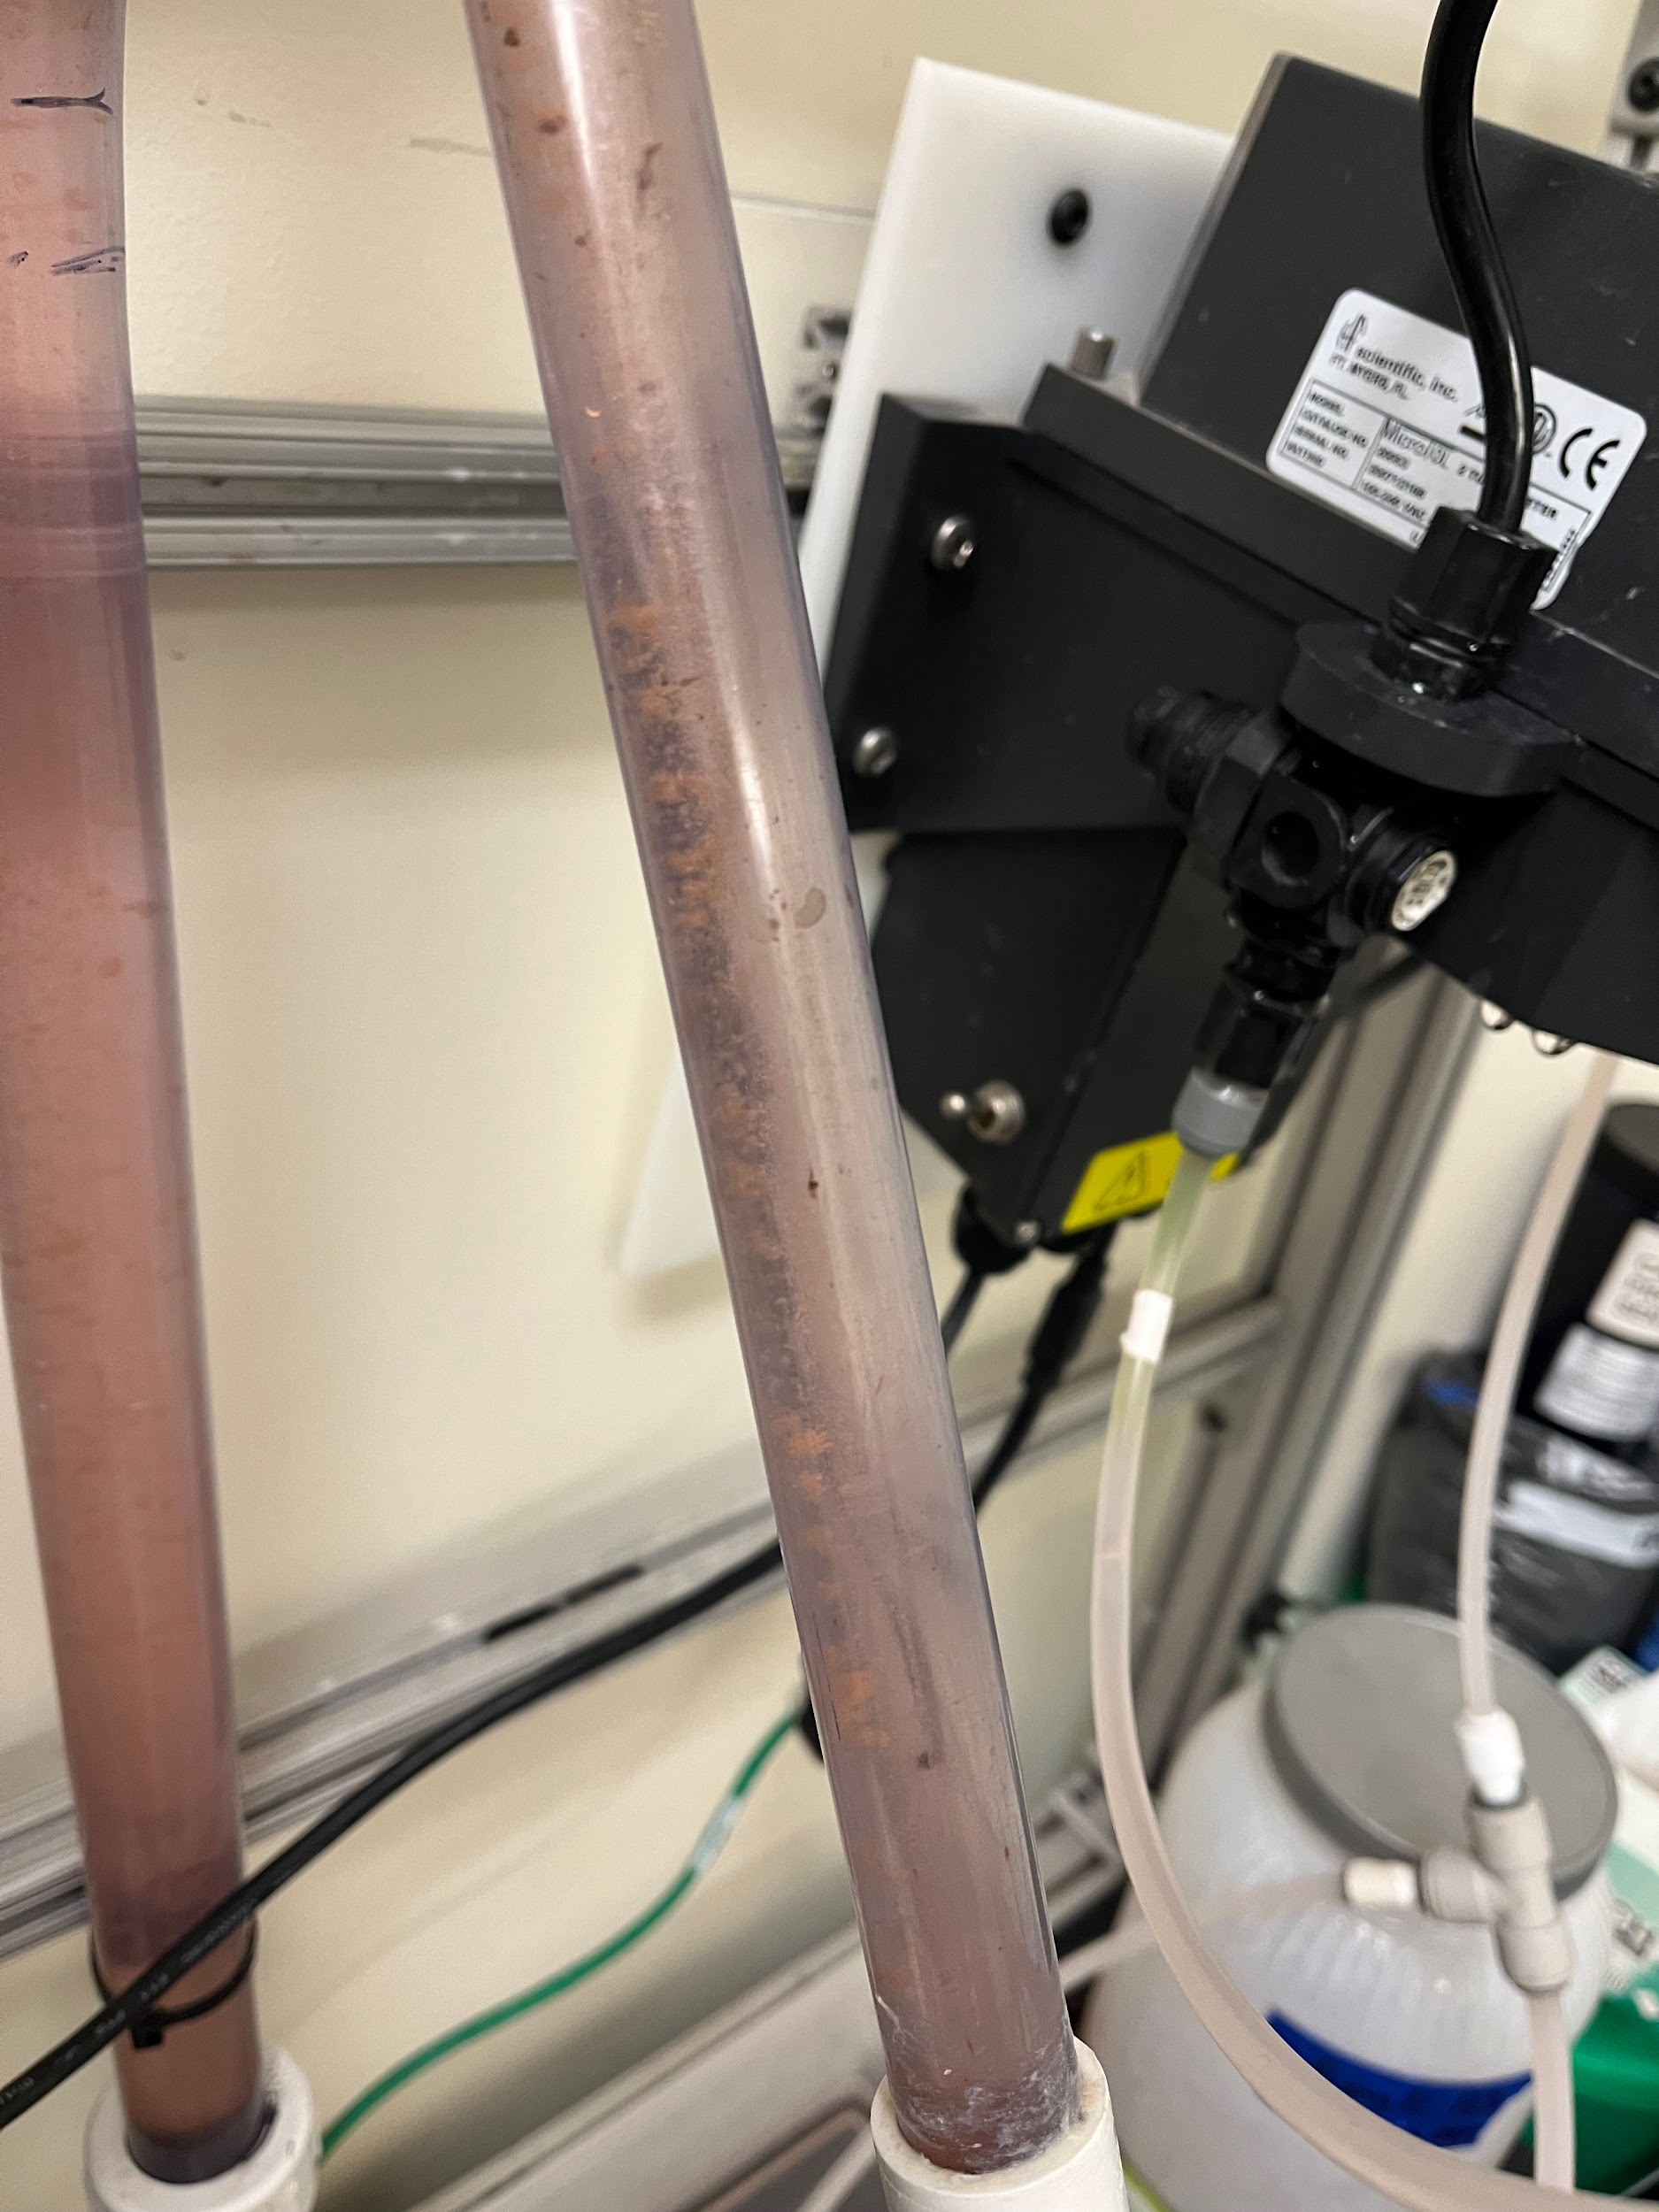
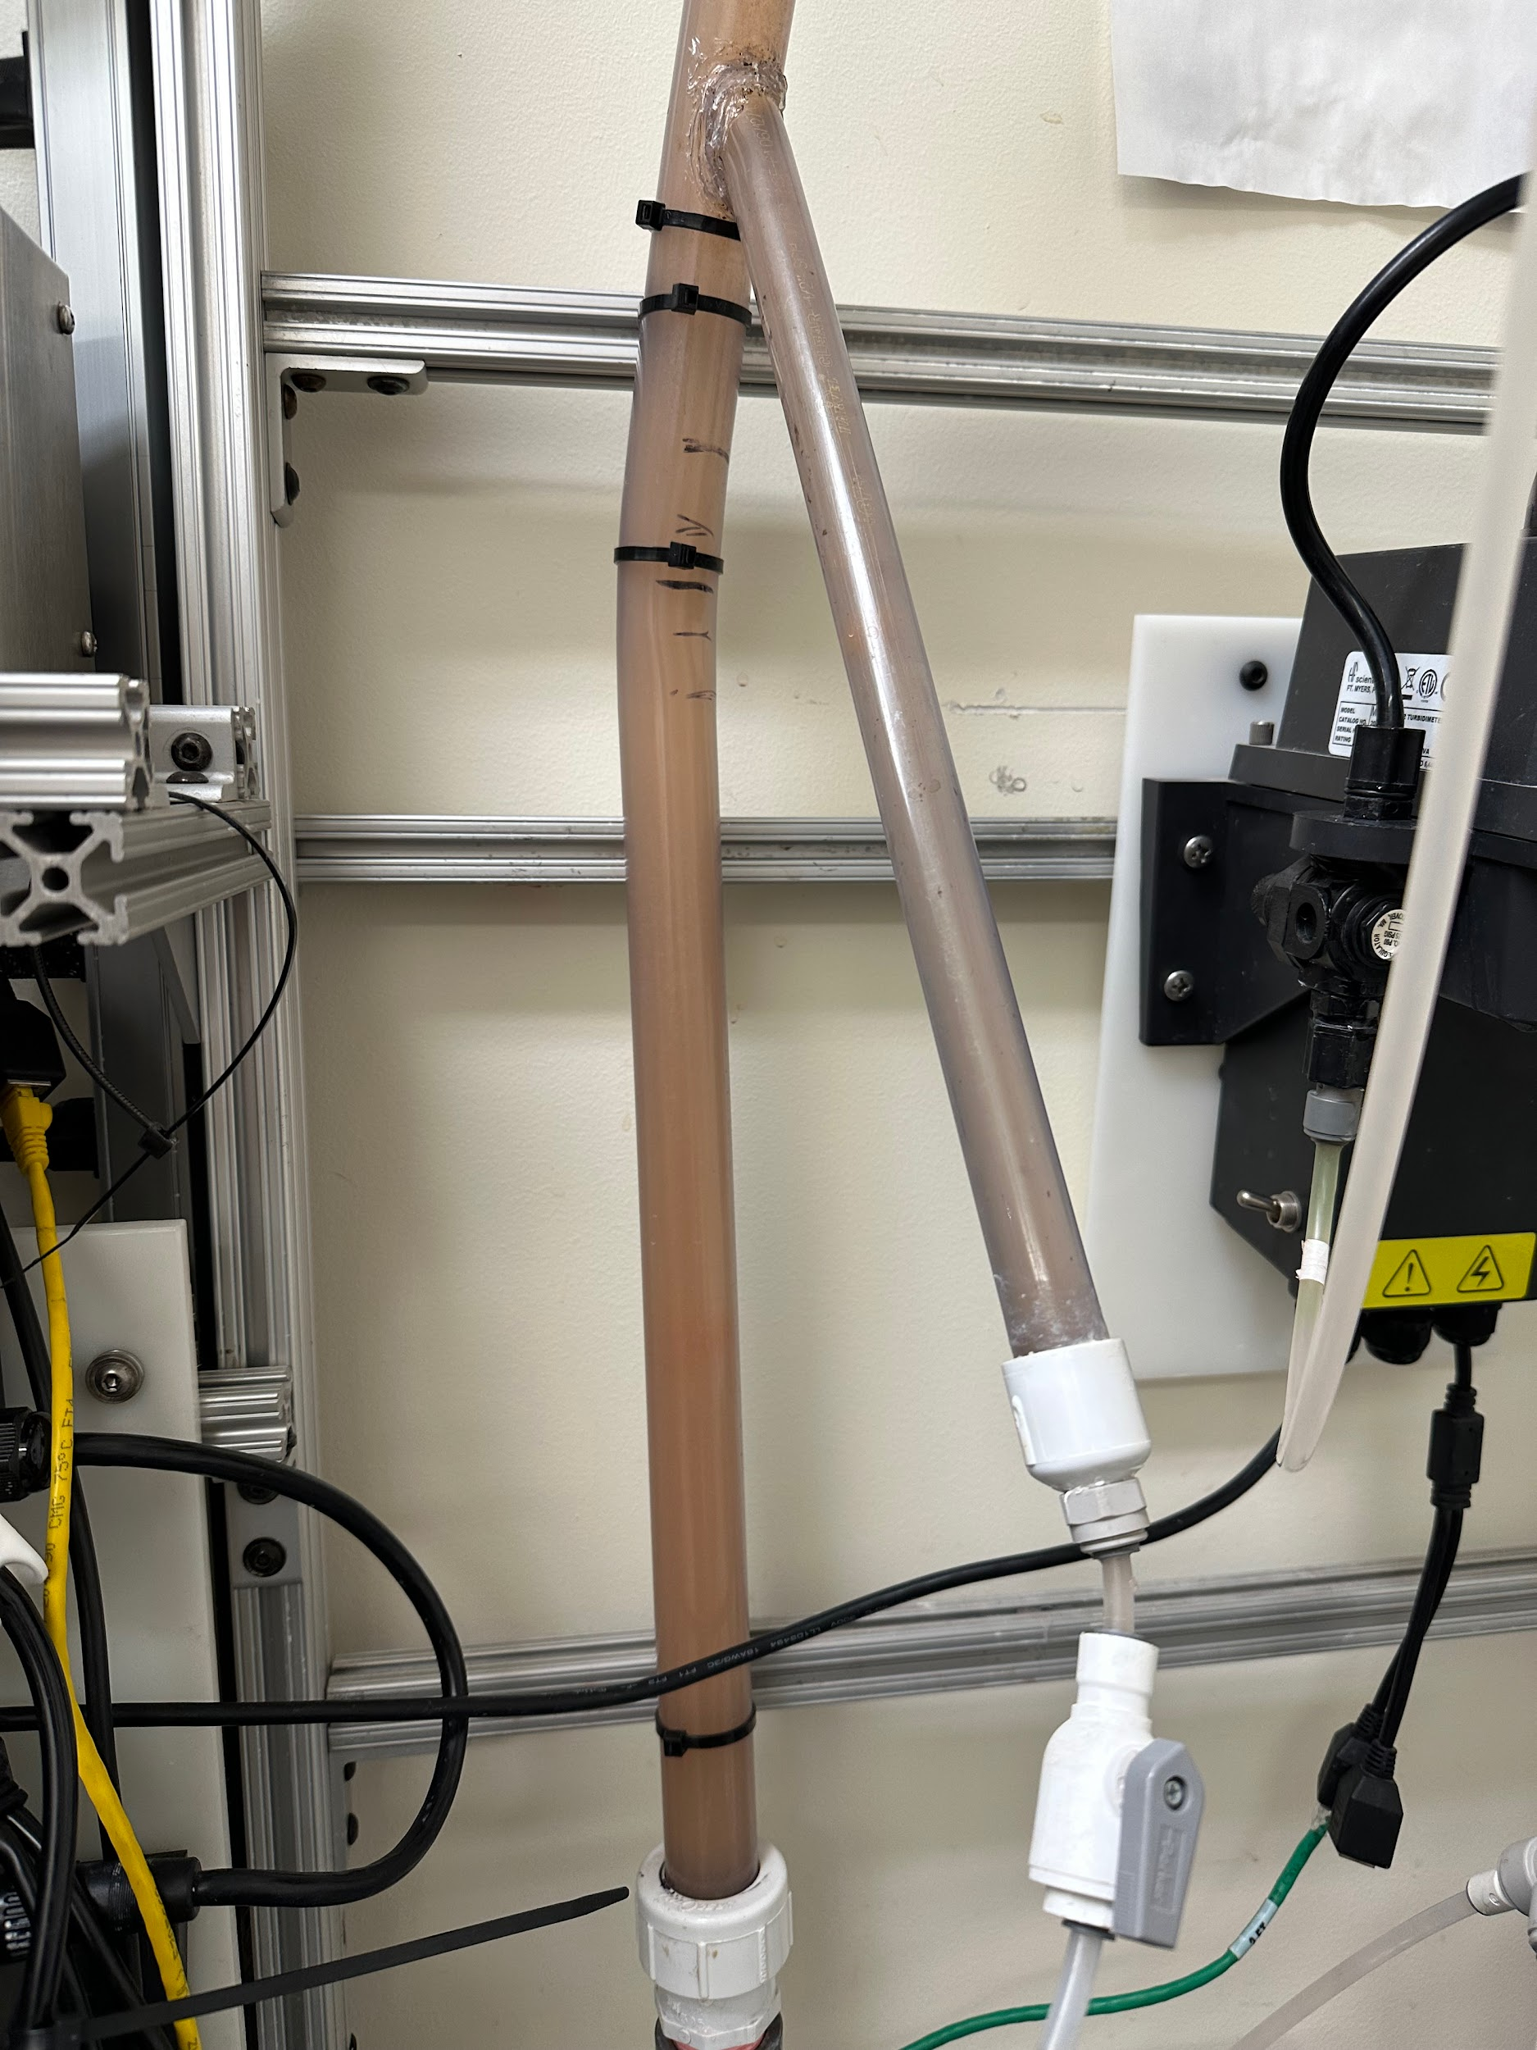
Results and Analysis
White particles
Many flocs of orange color from the humic acid solution
Orange murky water
Red-ish water from humic acid solution
Clear water encompassing the flocs
Figure 7: Image of sedimentation tank from experiments from last semester
Figure 8: Run with 100 mg/L of PaCl and 5 g/L of clay with 5 mg/L of humic acid
Figure 9: Run with 720 mg/L of PaCl and 10 g/L of clay with 5 mg/L of humic acid
Dissolved Organic Matter | Research | Final Presentation Fall 2022 | Page 14
Notes:
Brooke
In figure 8 on the left you can see how flocs are traditionally formed with flocs in clean water which will be separated in the separation tank. This makes sense because of our humic concentration is red and all the humic acid are turned into flocs and the leftover water is clean.
However, we were running into many issues with flocs forming in our experiment in determining the optimal coagulant dosage for 5 mg/L of humic acid. In the center image you can see the water in the sedimentation tank is red and the particles suspended are not colored. This raises an alarm because either the humic acid are not forming flocs or the dye is not adhering to the flocs. We did test these two factors, but did not find conclusive results. We changed the dye to lab based dye and the same white particles were produced. We also added more coagulant which proved the white particles can be flocs since more of these particles formed.
After adding more coagulant and clay in hopes of forming more and bigger flocs, the water is not as red and is orange as seen on the right. Also, the water is very murky that the flocs can not be seen. We will test for more factors that can be potentially causing this issue during the rest of the semester such as pH or flowrates.

Slide 15
Future Work
Run experiments to find out why the flocs are not forming well
Vary concentrations of humic acid and concentrations of coagulant to demonstrate a positive relationship among both solutions
Run experiments of humic acid with its corresponding optimal coagulant concentrations and with varying concentrations of clay and activated carbon
Dissolved Organic Matter | Research | Final Presentation Fall 2022 | Page 15
Notes:
Brooke
as shown in photos, you can see that we have had issues with floc formulation. our future work entails figuring out why flocs aren’t forming well.
as we discussed in our previous symposium, our main task remains to vary the concentrations of humic acid and the coagulant (PaCl) to prove that there is a positive relationship among both solutions. this is a continuation of the work done by the humic acid subteam, which researched the same relationship. however the humic acid team found that when humic acid concentrations were 5 and 10 mg/L, there was a negative relationship. We believe that there is a positive relationship because of literature review. as such, we want to prove the positive relationship and establish that the previous data contained an anomaly.
we are also planning to run experiments humic acid with its corresponding optimal coagulant concentrations and with varying concentrations of clay and activated carbon. we are interested in seeing how the amount of clay and activated carbon effects the ability for flocs to form.

Slide 16
Questions
and/or
Recommendations?
Rachel Lai | rml267@cornell.edu Nhi Nguyen | npn25@cornell.edu
Zachary Kwon | zk49@cornell.edu Brooke Paykin | bsp67@cornell.edu
Mateo Aranzazu | ma956@cornell.edu
Dissolved Organic Matter | Research | Final Presentation Fall 2022 | Page 16
Notes:
Brooke
Atlas, this is the end of the presentation. If you have any questions or recommendations, feel free to contact anyone on the team. Thank you for listening!

Slide 17
References
Logan, B. E., Hermanowicz, S. W., & Parker, A. S. (1987). A Fundamental Model for Trickling Filter Process Design. Journal (Water Pollution Control Federation), 59(12), 1029–1042.
Matilaninen, A, Vepsalainen, M & Sillanpaa, M. (2010). Natural Organic Matter Removal by Coagulation during Drinking Water Treatment. Adv Colloid Interface Sci.
Soh, YC, Roddick, F & Van Leeuwen, J. (2008). The Impact of Alum Coagulation on the Character, Biodegradability and Disinfection By-product Formation Potential of Reservoir Natural Organic Matter (NOM) Fractions. Water Sci Technol. 58(6), 1173-9.
Kopfler, F., H. Ringhand, W. Coleman, AND J. Meier. REACTIONS OF CHLORINE IN DRINKING WATER, WITH HUMIC ACIDS AND 'IN VIVO'. U.S. Environmental Protection Agency, Washington, D.C., EPA/600/D-84/196 (NTIS PB85160737).
Du, Y. (2017). Observations and a Geometric Explanation of the Effects of Humic Acid on Flocculation.
Lin, V. S. (2015). Research highlights: Challenges in the characterization, storage, and isolation of natural organic matter. Environmental Science: Processes & Impacts, 17(12), 2002–2005. https://doi.org/10.1039/c5em90046h
Powdered activated carbon. Eleven Carbon ™. (2022, April 3). Retrieved October 17, 2022, from https://elevencarbon.com/powdered-activated-carbon/
Dissolved Organic Matter | Research | Final Presentation Fall 2022 | Page 17

Slide 18
Appendix
Slides
Dissolved Organic Matter | Research | Final Presentation Fall 2022 | Page 18

Slide 19
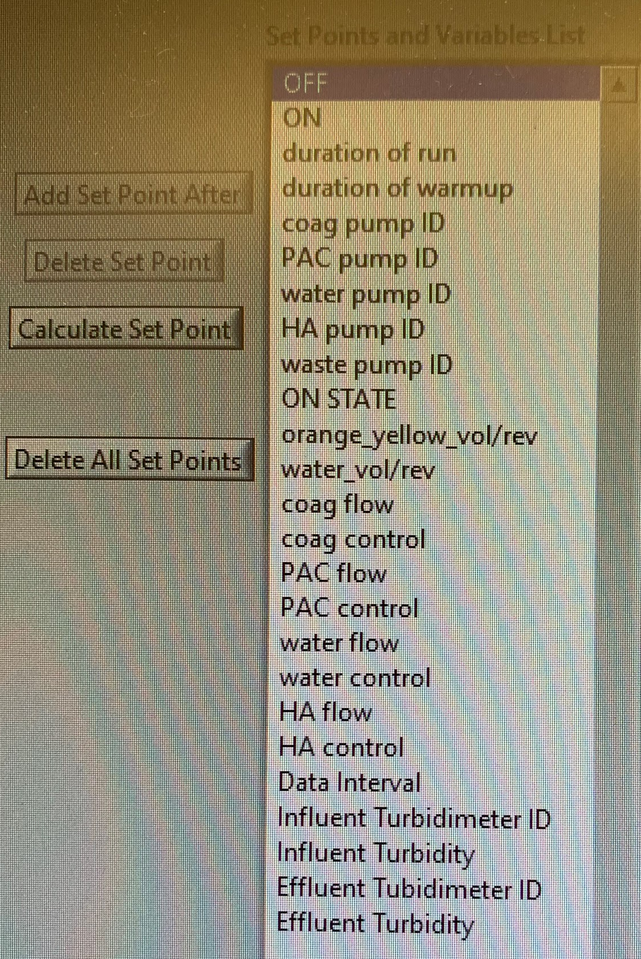
Setpoints
Figure 10: Image of the setpoints of the ProCoDA method file
Dissolved Organic Matter | Research | Final Presentation Fall 2022 | Page 19
Notes:
Attached above is an image of our ProCoDA setpoints.

